Slide 1
SRVUSD
Strategic Directions Planning
Board Presentation June 1, 2021

Slide 2
Presentation Overview
Transformational change rests on the foundation of all of the successes the District has previously experienced and it usually demands some change of culture and practice in the system.

Slide 3
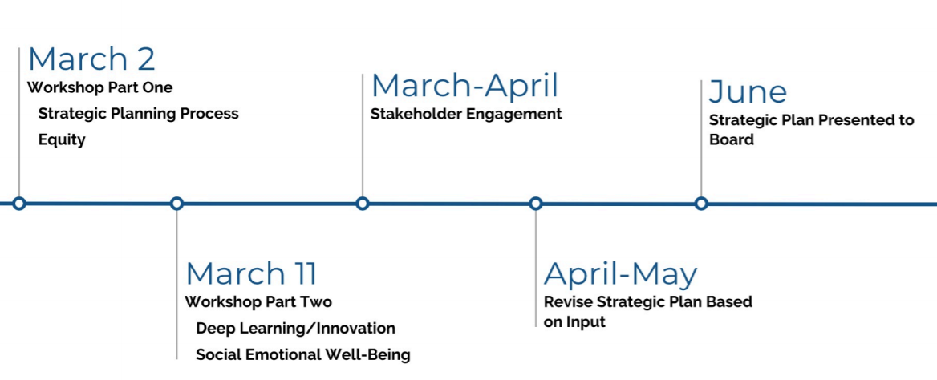
March 2
March - April
June
6/1
First DRAFT
6/15
Finished Plan/LCAP
March 11
April - May
Timeline

Slide 4
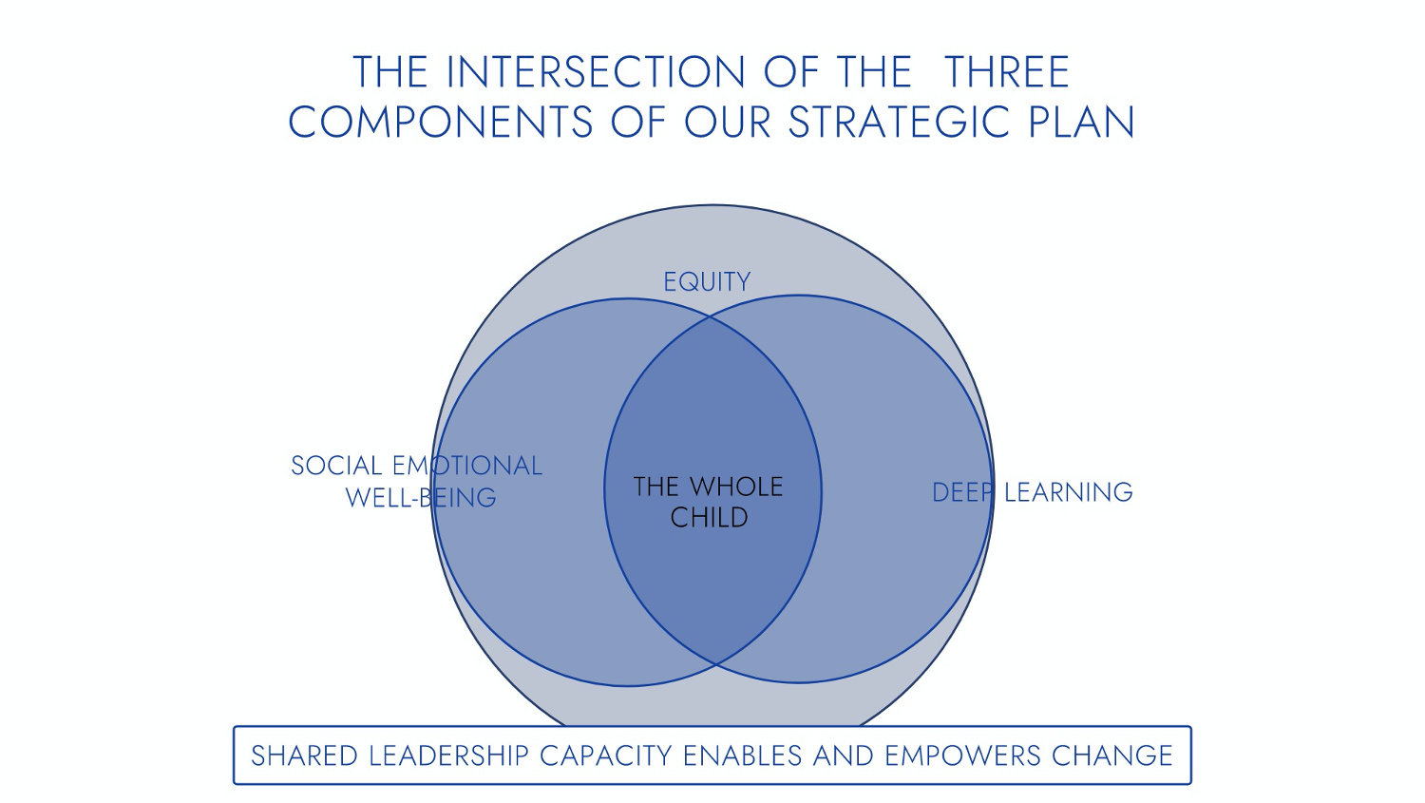
Intersection of Plan Components
A CULTURE OF RESPONSIVENESS ALLOWS US TO FOCUS ON OUR STUDENTS
EFFECTIVE GOVERNANCE PROVIDES SIGNIFICANT OVERSIGHT AND STRATEGIC DIRECTION
SHARED LEADERSHIP CAPACITY ENABLES AND EMPOWERS CHANGE
EFFECTIVE STEWARDSHIP OF RESOURCES ALLOWS US TO USE OUR AVAILABLE RESOURCES EFFECTIVELY AND DETERMINE HOW TO AFFORD THE
SRVUSD STANDARD OF EXCELLENCE

Slide 5
Unique Opportunity to Coordinate Our Work
The system collaboratively creates and communicates the District plan. The schools create their goals and strategies based on this plan and their local context.
Strategic Directions
SRVUSD Strategic Plan
Learning Continuity and Attendance Plan (LCP)
Local Control and Accountability Plan
(LCAP)

Slide 6
Learning Continuity and Attendance Plan (LCP) - Challenges and Successes
The LCP provides analysis on the following topics:
Actions Related to In-Person Instructional Offerings
Actions Related to the Distance Learning Program
Actions Related to Pupil Learning Loss
Analysis of Mental Health and Social and Emotional Well-Being
Analysis of Pupil and Family Engagement and Outreach
Analysis of School Nutrition
Original Plan: Approved September 2020
What we intended to do in each topic
Revised Plan for Approval: June 15, 2021
How we actually did in each topic
Changes and Adjustments were made through feedback, focus groups and analysis.
Complete information can be found in the plan.

Slide 7
SRVUSD…Where all students thrive in innovative and inclusive learning communities.

Slide 8
Broadening the definition of success on the already existing academic excellence

Slide 9
Strategic Planning Process
August - January

Slide 10
The work we will continue as we engage with the Strategic Process
Start the 21-22 school year differently
Continue with Fastbridge
Work on multi-tiered systems of support and grading
Continue examining issues of access to the instruction, programs, and interventions our students need
Provide facilitated equity learning opportunities for all staff
Implement the components of the Responding to Discrimination and Hate Handbook
Strengthen our reporting mechanisms when issues of discrimination occur

Slide 11
Strategic Direction 1:
Equity
SRVUSD will ensure that all students are empowered to reach their full potential by valuing student voice, addressing systemic inequities, and closing opportunity gaps.

Slide 12
Strategic Direction 2:
Social Emotional Well-Being
SRVUSD is committed to creating and nurturing inclusive learning environments where all students, staff, and families feel deeply connected to their school community.

Slide 13
Strategic Direction 3:
Deep Learning and Innovation
SRVUSD will create learning environments that empower students to take ownership over their learning in order for them to find purpose, meaning, and joy in their education and to excel in post-high school endeavors.

Slide 14
Strategic Direction 4:
Shared Leadership
SRVUSD will create the conditions for shared leadership by building a culture of trust, collegiality, and shared responsibility with students, staff, and families.

Slide 15
Strategic Direction 5:
Effective Stewardship of Resources
SRVUSD will maximize resources including time, talent and finances, to advance our student success goals.

Slide 16
Strategic Direction 6:
Culture of Responsiveness
SRVUSD will effectively serve all stakeholders by listening, responding to questions and concerns in a timely fashion, changing processes and practices when appropriate, and communicating the rationale for decisions so our students’ learning and social emotional well-being remain the focus of our efforts.

Slide 17
Proposed Steering Committee Structure for the Strategic Plan
Required Committees:
Review and Shift to Local Control and Accountability Plan Committee (LCAP)
Facilities Oversight and Advisory Committee (FOAC)
Parcel Tax Oversight Committee (PTOC)
English Learner Advisory Committee (ELAC)
District English Learner Advisory Committee (DELAC)
Additional Committees:
Equity Committee
Social Emotional Well-Being Committee
Deep Learning and Innovation Committee

Slide 18
Proposed Systemic Shifts in Culture and Practice
Broadening definition of success while maintaining high standards for academic achievement
Strengthening and enhancing shared leadership and responsiveness
Prioritizing equity and inclusion as a condition for all students’ success
Changing instruction, assessment, and intervention strategies as necessary to support the strategic directions

Slide 19
Please Respond to the Strategic Direction in This Way
Gather Feedback on DRAFT Strategic Plan:
Please visit our ThoughtExchange:
https://my.thoughtexchange.com/267291818
Use feedback and Board input to create a final document for consideration at the June 15th meeting.
Gather Feedback on LCAP and Updated LCP:
Email SRVUSD Executive Director, Educational Services Jon Campopiano
jcampopiano@srvusd.net
Use feedback and Board input to create a final document for consideration at the June 15th meeting.

Slide 20
For Our Trustees
How can staff help inform your direction?
What do you want to see?
What might we need to include?
What may be missing?
What needs more clarification?
This is still a work in progress...

